Slide 1
CAPSTONE PROJECT – WHERE TO MOVE DUE TO BREXIT ?
IBM / COURSERA CERTIFICATION

Slide 2
Table of contents
Business problem
Data
Methodology
Analysis
Results and discussion
Conclusion

Slide 3
BUSINESS PROBLEM
This project deals with the following question:
Banks with their HQ in the UK (especially London) consider moving their HQ to cities which belong to EU countries. This is due to the Brexit, which will implement some substantial hurdles for banks to make business in the EU market, if their HQ is located in the UK.
The question now is: „which EU city, which has a relevant stock exchange located in its city area, is similar to London ?“
The target audience consists of decision makers at the banks.

Slide 4

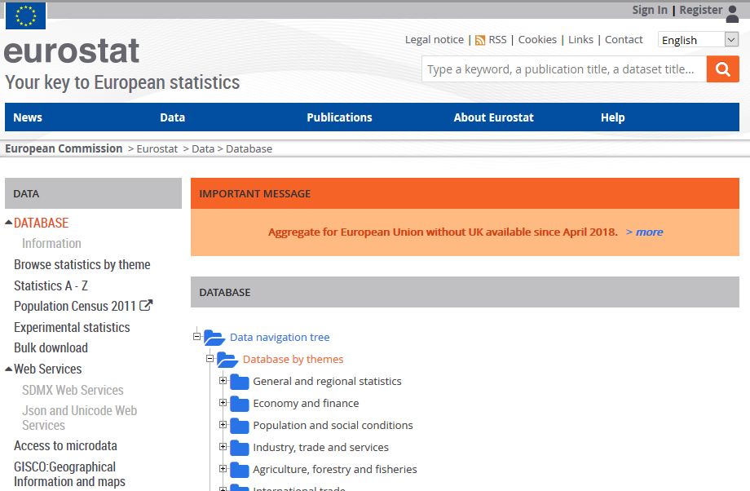
DATA
The data used for this investigation was retrieved from the eurostat database, which offers publicly available data on various topics related to the EU (https://ec.europa.eu/eurostat/data/database).
The following parameters / cities were identified to be relevant for the project scope

Slide 5
DATA - Parameters
The percentage of country inhabitants with an education level of 5-8 acc. the International Standard Classification of Education (ISCED)(2018)
The labor costs in the respective country [€] (2018)
The average monthly rent in the candidate city [€/m^2] (2018)
Consumer prices acc. to the Harmonized Index of Consumer Prices (HICP) (2018)
Crime rate / 100'000 inhabitants for the respective country
The number of universities in the city area
The difference in time zones compared to London
The life satisfaction index (2018)for the respective country
The number of active companies for the respective country (2017)

Slide 6
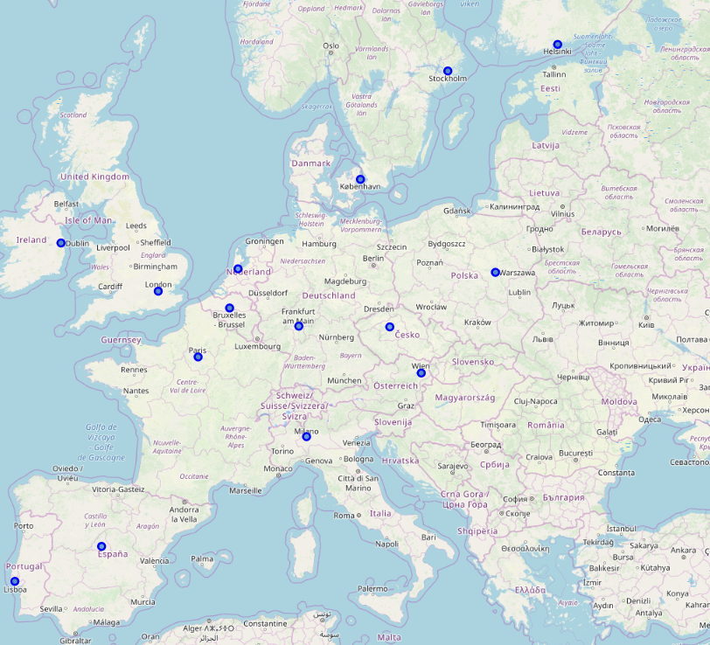
DATA – Evaluated Cities
Northwest Europe:
Dublin, Ireland
Southwest Europe :
Madrid, Spain / Lisbon, Portugal
Northeast Europe :
Stockholm, Sweden / Helsinki, Finland / Warsaw, Poland
Central Europe:
Frankfurt, Germany / Paris, France / Brussels, Belgium / Amsterdam, Netherlands / Copenhagen, Denmark / Vienna, Austria / Prague, Czech Republic
South Europe:
Milan, Italy

Slide 7
Methodology
In this project we will try to find an alternative city, to which banks with their current HQ in London / UK can move to, in order to avoid negative consequences due to the upcoming Brexit. To do so, we followed the steps below:
We first imported a prepared data set through the cloning of my git repository, and transformed it into a pandas DataFrame
We created a second DataFrame, and store the geographical coordinates of the evaluated cities in it
A first map is created, to visualize the geographical locations of the cities
2 different clustering algorithms are tested on the first Dataframe: KMeans & DBScan
The results of the 2 cluster analyses are shown on separate maps, in order to make it easier to identify the alternative candidates

Slide 8

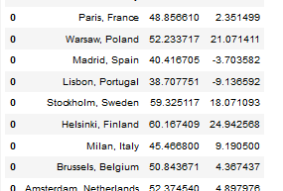
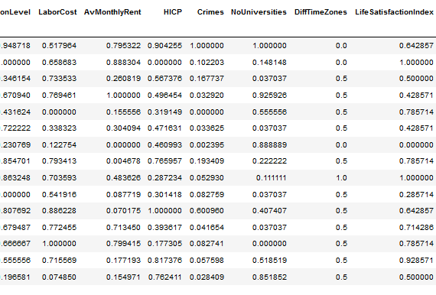
Analysis
Review of DataFrames to ensure data readiness

Slide 9
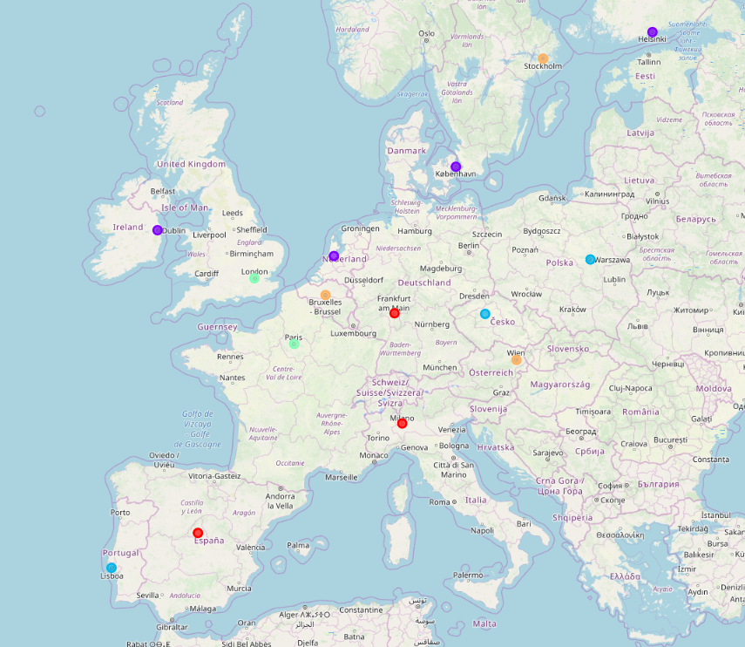
Analysis
KMeans algorithm
N° of clusters tested: 2-9
Best cluster range from 3-5
Below: no similar city
Above: too many candidates

Slide 10
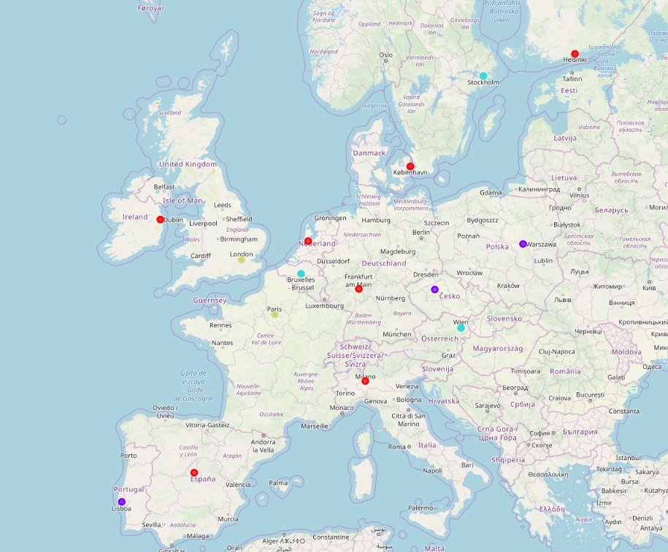
Analysis
DBSCAN algorithm
Minimum of 2 samples per cluster defined
Best configuration found for epsilon = 0.8 – 1.2
Below: too many candidates
Above: no candidate

Slide 11
Results, Discussion & Conclusion
The analysis shows that the only candidate city which can be considered similar enough is Paris, France.
Using the KMeans algorithm, various groupings can be obtained, with only a small range of k clusters giving reasonable results. For only 2 clusters, the cities of Lisbon, Madrid, Paris, Frankfurt, Milan, Prague ad Warsaw are considered to be similar to London. As this result is not helping a decision, it is not used for the decision process. Within the range of 3-5 clusters, only Paris is considered to be an alternative to London. For a number of clusters higher than 5, there is no similar city in the evaluated candidate group. Therefore the only reasonable configuration to use for the decision process is with 3-5 clusters.
For DBSCAN, the amount of minimum samples was set to 2 samples, as this would be enough to provide at least one candidate city which is similar to London. Therefore the other parameter changed was the epsilon parameter. Reducing this parameter from 2 to 0.1 in steps of 0.05, it becomes clear that values above 1.2 do not provide a similar city. Between 0.8 and 1.2, again Paris is the only city being considered an alternative to London. At 0.75, the next city added to the potential locations is Dublin. Below 0.75, further cities are added to this list, so that a reasonable recommendation cannot be given.
Given the results discussed above, only 2 cities can be considered a realistic alternatives compared to the current location in London: Paris and Dublin. This recommendation can be used for a in detail review of locations, involving other factors which were not included in this investigation, e.g. taxes to pay, infrastructure etc.

